Slide 1
Chapter 3: Network Access
Introduction to Networks

Slide 2
Chapter 3: Objectives
Upon completion of this chapter, you will be able to:
Identify device connectivity options.
Describe the purpose and functions of the physical layer in the network.
Describe basic principles of the physical layer standards.
Identify the basic characteristics of copper cabling.
Build a UTP cable used in Ethernet networks.
Describe fiber-optic cabling and its main advantages over other media.
Describe wireless media.
Select the appropriate media for a given requirement and connect devices.
Notes:
2
Chapter 4 Objectives

Slide 3
Chapter 3: Objectives (cont.)
Upon completion of this chapter, you will be able to:
Describe the purpose and function of the data link layer in preparing communication for transmission on specific media.
Describe the Layer 2 frame structure and identify generic fields.
Identify several sources for the protocols and standards used by the data link layer.
Compare the functions of logical topologies and physical topologies.
Describe the basic characteristics of media control methods on WAN topologies.
Describe the basic characteristics of media control methods on LAN topologies.
Describe the characteristics and functions of the data link frame.
Notes:
3
Chapter 4 Objectives (cont.)

Slide 4
Chapter 3
3.1 Physical Layer Protocols
3.2 Network Media
3.3 Data Link Layer Protocols
3.4 Media Access Control
3.5 Summary
Notes:
Chapter 4 Sections

Slide 5
3.1 Physical Layer Protocols

Slide 6
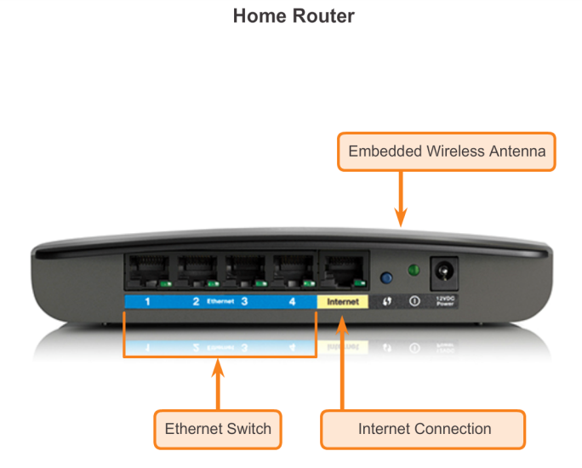
Getting it Connected Connecting to the Network

Slide 7
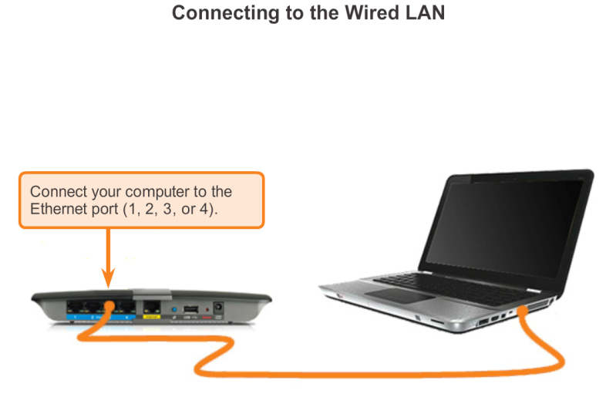
Getting it Connected Connecting to the Network (cont.)

Slide 8
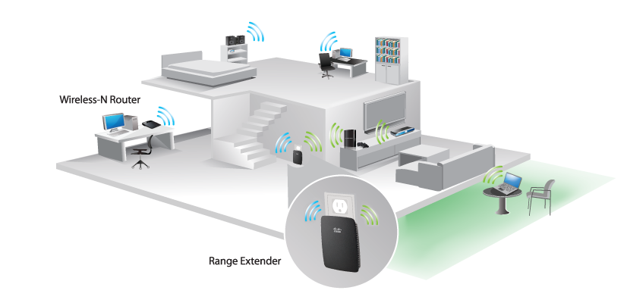
Getting it Connected Network Interface Cards
Connecting to the Wireless LAN with a Range Extender

Slide 9
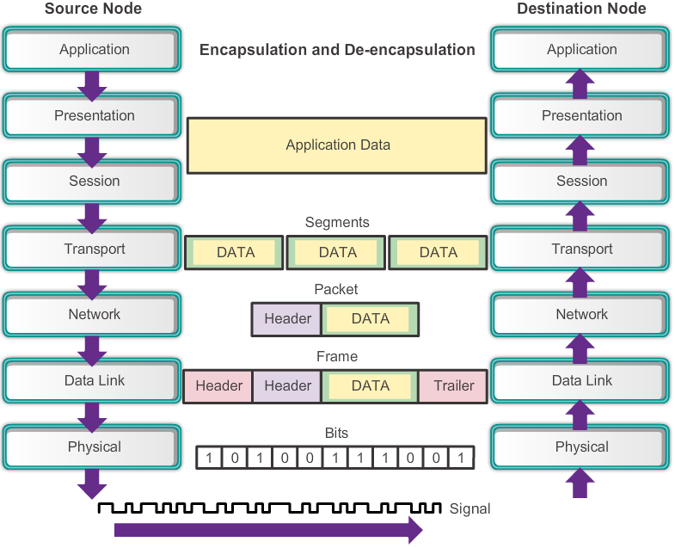
Purpose of the Physical Layer The Physical Layer

Slide 10
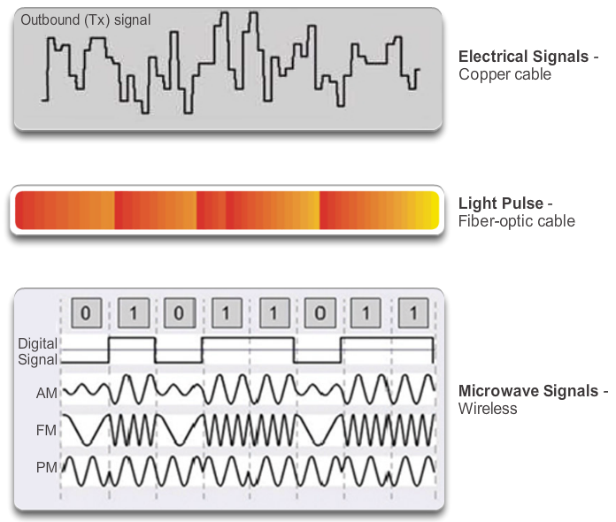
Purpose of the Physical Layer Physical Layer Media

Slide 11
Purpose of the Physical Layer Physical Layer Standards
Standard Organization | Networking Standards
ISO | ISO 8877: Officially adopted the RJ connectors (e.g., RJ-11, RJ-45) ISO 11801: Network cabling standard similar to EIA/TIA 568.
EIA/TIA | TIA-568-C: Telecommunications cabling standards, used by nearly all voice, video and data networks. TIA-569-B: Commercial Building Standards for Telecommunications Pathways and Spaces TIA-598-C: Fiber optic color coding TIA-942: Telecommunications Infrastructure Standard for Data Centers
ANSI | 568-C: RJ-45 pinouts. Co-developed with EIA/TIA
ITU-T | G.992: ADSL
IEEE | 802.3: Ethernet 802.11: Wireless LAN (WLAN) & Mesh (Wi-Fi certification) 802.15: Bluetooth

Slide 12
Fundamental Principles of Layer 1 Physical Layer Fundamental Principles
Media | Physical Components | Frame Encoding Technique | Signalling Method
Copper Cable | UTP Coaxial Connectors NICs Ports Interfaces | Manchester Encoding Non-Return to Zero (NRZ) techniques 4B/5B codes are used with Multi-Level Transition Level 3 (MLT-3) signaling 8B/10B PAM5 | Changes in the electromagnetic field Intensity of the electromagnetic field Phase of the electromagnetic wave
Fiber Optic Cable | Single-mode Fiber Multimode Fiber Connectors NICs Interfaces Lasers and LEDs Photoreceptors | Pulses of light Wavelength multiplexing using different colors | A pulse equals 1. No pulse is 0.
Wireless Media | Access Points NICs Radio Antennae | DSSS (direct-sequence spread-spectrum) OFDM (orthogonal frequency division multiplexing) | Radio waves

Slide 13
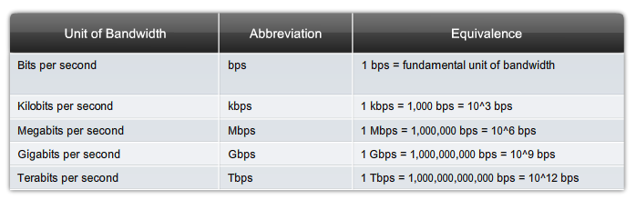
Fundamental Principles of Layer 1 Bandwidth

Slide 14
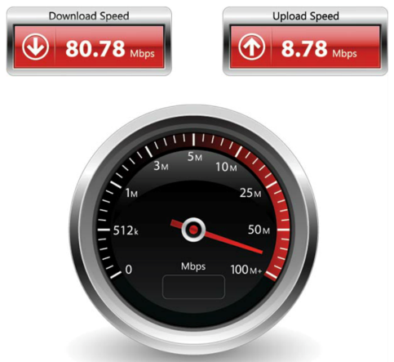
Fundamental Principles of Layer 1 Throughput

Slide 15
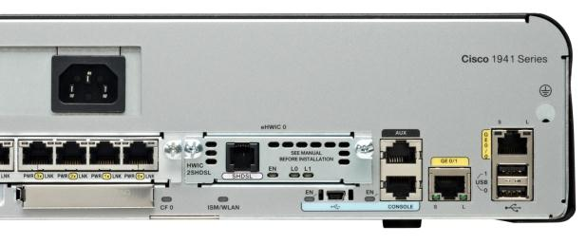
Fundamental Principles of Layer 1 Types of Physical Media
SHDSL
Interface
Management
Ports
Gigabit Ethernet
Interfaces
USB Type A
Connector
FastEthernet
Switch Ports
USB Mini-B
Connector
Notes:
4.1.3.4 Types of Physical Media

Slide 16
3.2 Network Media

Slide 17
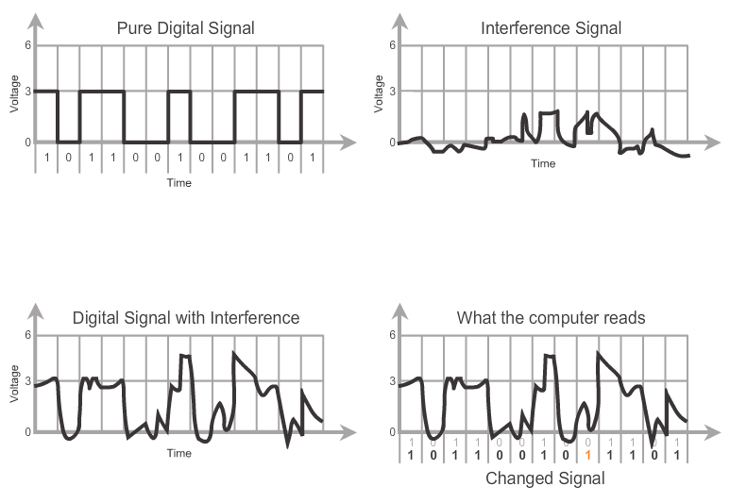
Copper Cabling Characteristics of Copper Media

Slide 18
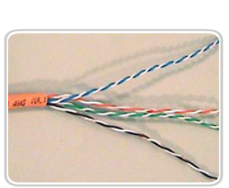
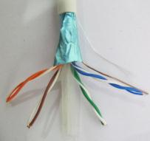
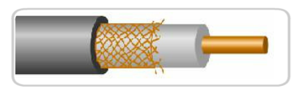
Copper Cabling Copper Media
Unshielded Twisted Pair (UTP) Cable
Shielded Twisted Pair (STP) Cable
Coaxial Cable

Slide 19
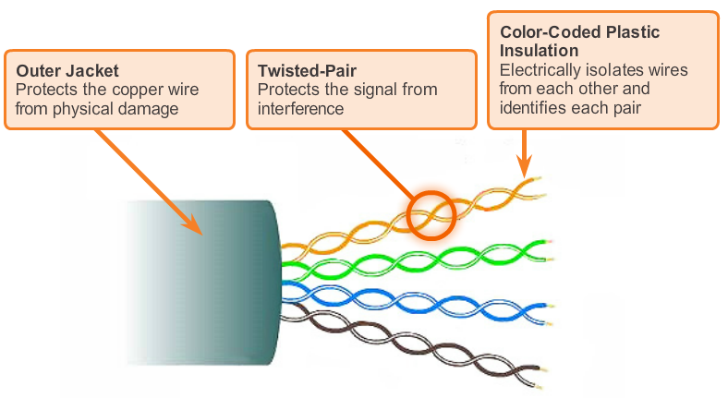
Copper Cabling UTP Cable

Slide 20
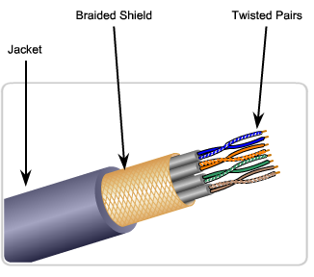
Copper Cabling STP Cable
Braided or Foil Shield
Foil Shields

Slide 21
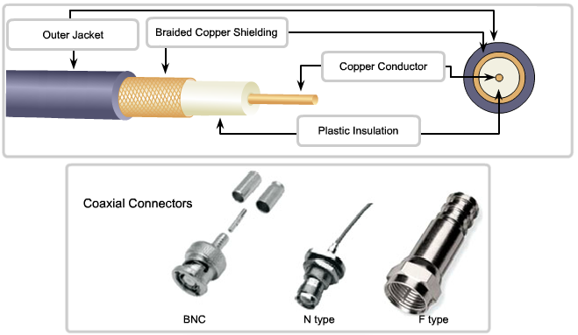
Copper Cabling Coaxial Cable

Slide 22
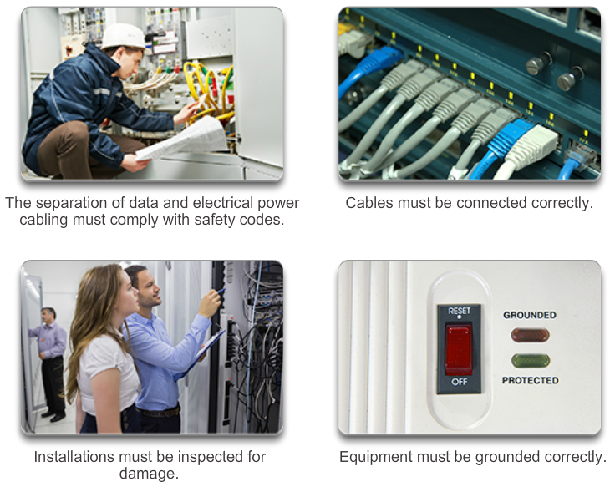
Copper Cabling Cooper Media Safety

Slide 23
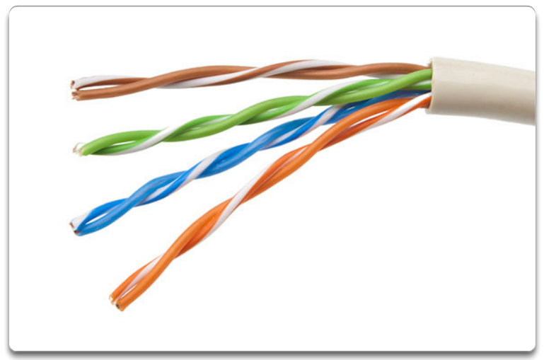
UTP Cabling Properties of UTP Cabling
UTP cable does not use shielding to counter the effects of EMI and RFI. Instead, cable designers have discovered that they can limit the negative effect of crosstalk by:
Cancellation
Varying the number of twists per wire pair

Slide 24
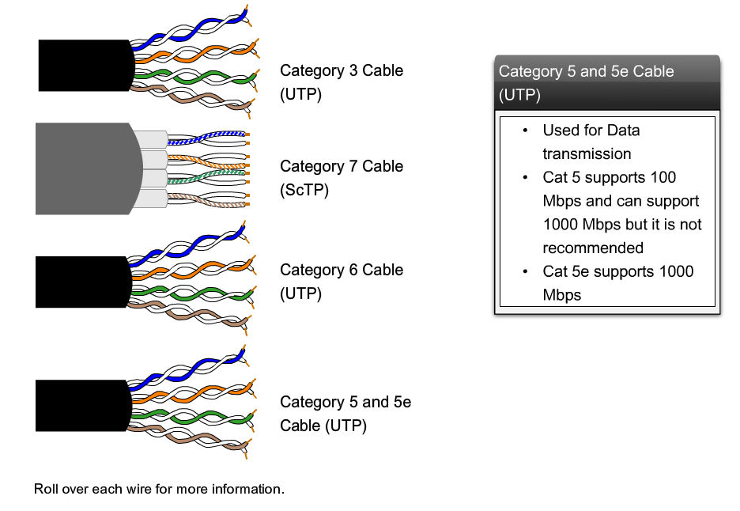
UTP Cabling UTP Cabling Standards
Notes:
4.2.2.2 UTP Cabling Standards

Slide 25
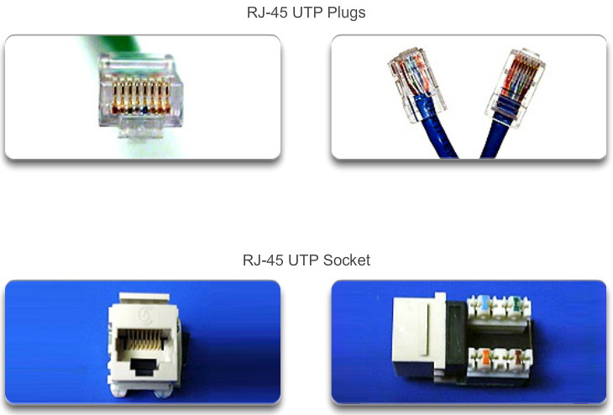
UTP Cabling UTP Connectors
Notes:
4.2.2.3 UTP Connectors

Slide 26
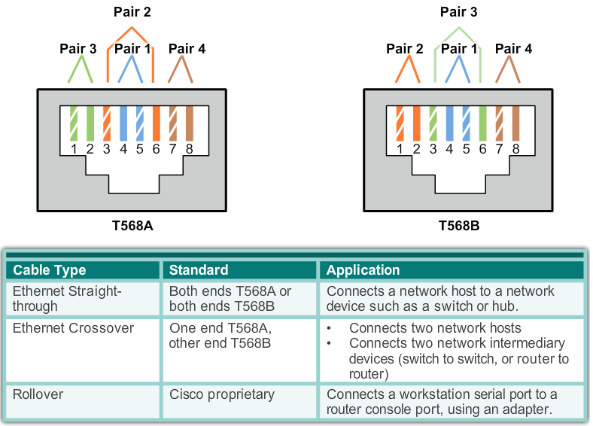
UTP Cabling Types of UTP Cable

Slide 27
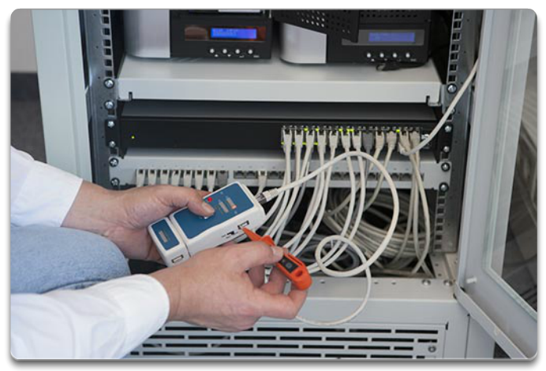
UTP Cabling Testing UTP Cables
After installation, a UTP cable tester should be used to test for the following parameters:
Wire map
Cable length
Signal loss due to attenuation
Crosstalk

Slide 28
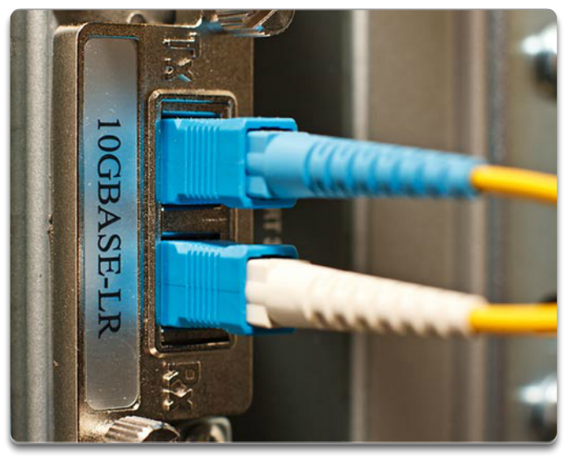
Fiber Optic Cabling Properties of Fiber Optic Cabling
Fiber-optic cabling is now being used in four types of industry:
Enterprise Networks
Fiber-to-the-home (FTTH) and Access Networks
Long-Haul Networks
Submarine Networks

Slide 29
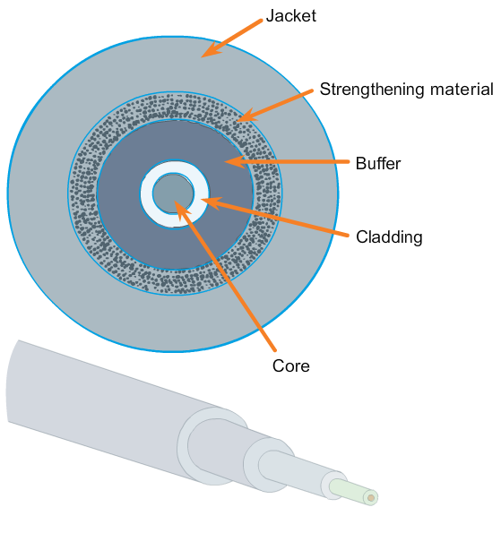
Fiber Optic Cabling Fiber Media Cable Design
Notes:
4.2.3.2 Fiber Media Cable Design

Slide 30
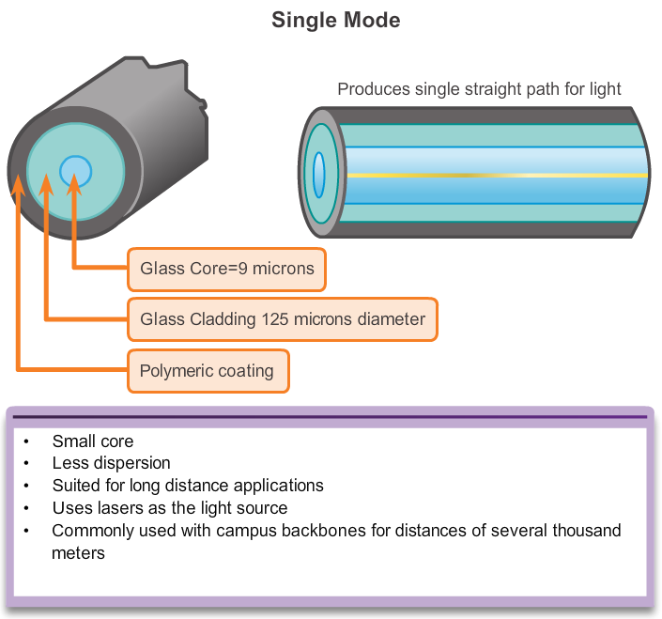
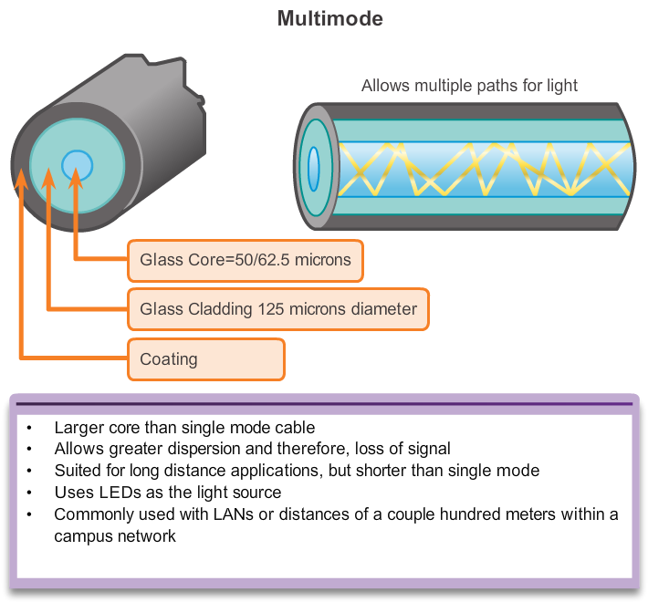
Fiber Optic Cabling Types of Fiber Media

Slide 31
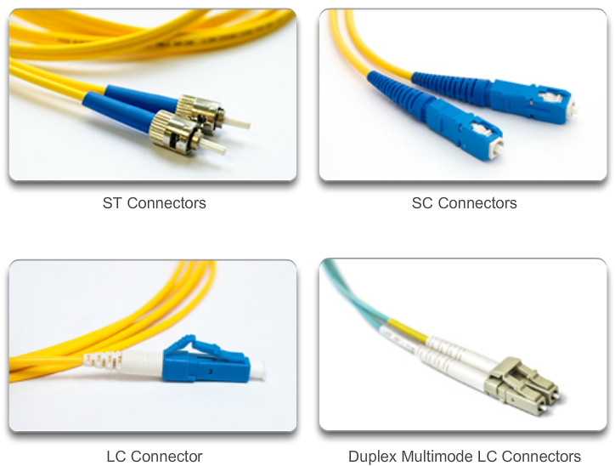
Fiber Optic Cabling Network Fiber Connectors

Slide 32
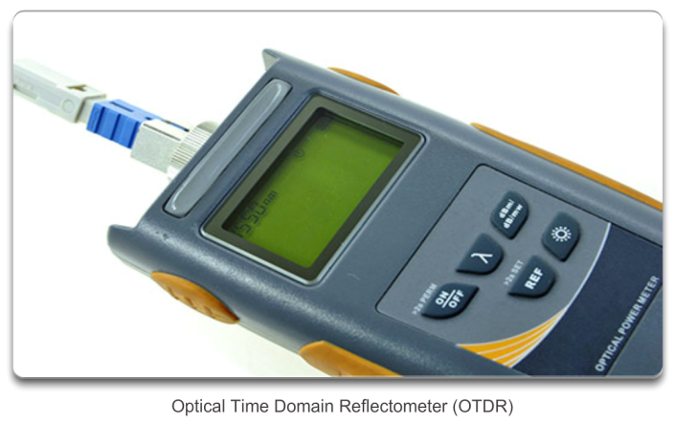
Fiber Optic Cabling Testing Fiber Cables

Slide 33
Fiber Optic Cabling Fiber versus Copper
Implementation Issues | Copper Media | Fibre Optic
Bandwidth Supported | 10 Mbps – 10 Gbps | 10 Mbps – 100 Gbps
Distance | Relatively short (1 – 100 meters) | Relatively High (1 – 100,000 meters)
Immunity To EMI And RFI | Low | High (Completely immune)
Immunity To Electrical Hazards | Low | High (Completely immune)
Media And Connector Costs | Lowest | Highest
Installation Skills Required | Lowest | Highest
Safety Precautions | Lowest | Highest

Slide 34
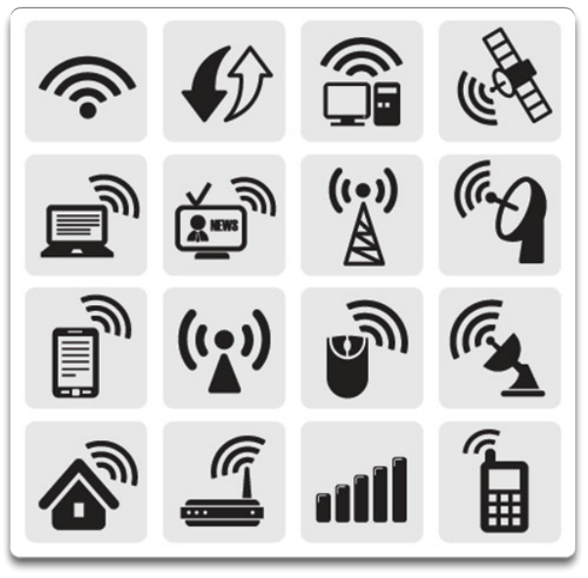
Wireless Media Properties of Wireless Media
Wireless does have some areas of concern including:
Coverage area
Interference
Security

Slide 35
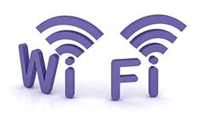


Wireless Media Types of Wireless Media
 | IEEE 802.11 standards Commonly referred to as Wi-Fi. Uses CSMA/CA Variations include: 802.11a: 54 Mbps, 5 GHz 802.11b: 11 Mbps, 2.4 GHz 802.11g: 54 Mbps, 2.4 GHz 802.11n: 600 Mbps, 2.4 and 5 GHz 802.11ac: 1 Gbps, 5 GHz 802.11ad: 7 Gbps, 2.4 GHz, 5 GHz, and 60 GHz
 | IEEE 802.15 standard Supports speeds up to 3 Mb/s Provides device pairing over distances from 1 to 100 meters.
 | IEEE 802.16 standard Provides speeds up to 1 Gbps Uses a point-to-multipoint topology to provide wireless broadband access.
Notes:
4.2.4.2 Types of Wireless Media

Slide 36
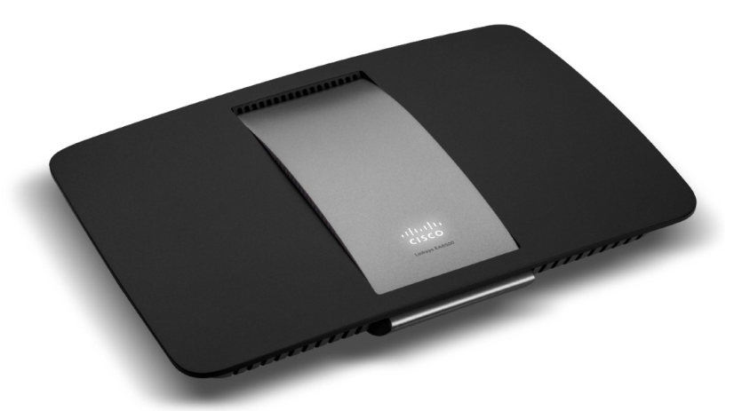
Wireless Media Wireless LAN
Cisco Linksys EA6500 802.11ac Wireless Router
Notes:
4.2.4.3 Wireless LAN

Slide 37
Wireless Media 802.11 Wi-Fi Standards
Standard | Maximum Speed | Frequency | Backwards Compatible
802.11a | 54 Mbps | 5 GHz | No
802.11b | 11 Mbps | 2.4 GHz | No
802.11g | 54 Mbps | 2.4 GHz | 802.11b
802.11n | 600 Mbps | 2.4 GHz or 5 GHz | 802.11b/g
802.11ac | 1.3 Gbps (1300 Mbps) | 2.4 GHz and 5.5 GHz | 802.11b/g/n
802.11ad | 7 Gbps (7000 Mbps) | 2.4 GHz, 5 GHz and 60 GHz | 802.11b/g/n/ac
Notes:
4.2.4.4 802.11 Wi-Fi Standards

Slide 38
3.3 Data Link Layer Protocols
Notes:
Cisco Networking Academy program
Introduction to Networks
Chapter 4: Network Access

Slide 39
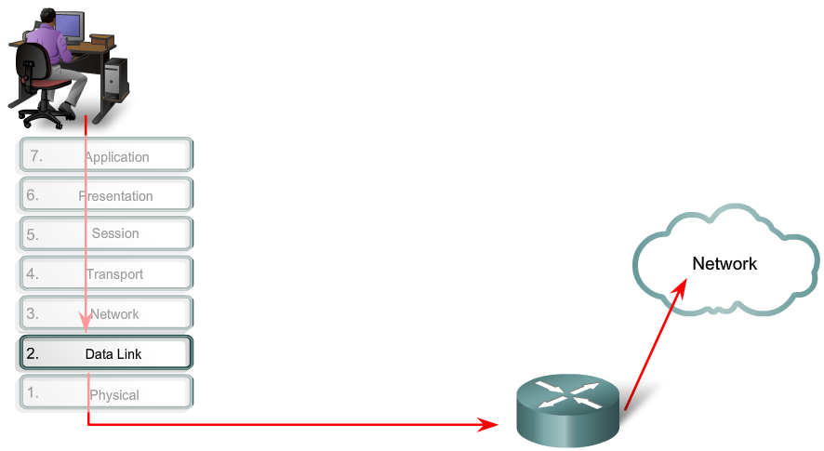
Purpose of the Data Link Layer The Data Link Layer

Slide 40
Purpose of the Data Link Layer Data Link Sublayers
Network
Data Link | LLC Sublayer
 | MAC Sublayer
Physical
802.3
Ethernet
802.11
Wi-Fi
802.15
Bluetooth

Slide 41
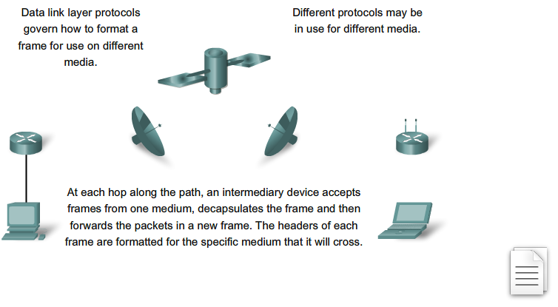
Purpose of the Data Link Layer Media Access Control
The Data Link Layer

Slide 42
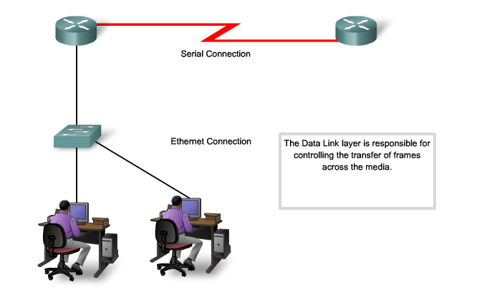
Purpose of the Data Link Layer Providing Access to Media

Slide 43
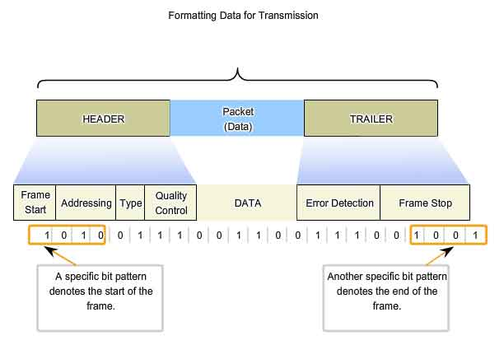
Data Link Layer Formatting Data for Transmission

Slide 44
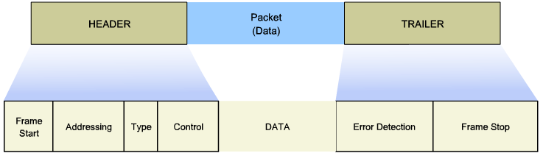
Layer 2 Frame Structure Creating a Frame

Slide 45
Layer 2 Standards Data Link Layer Standards
Standard organization | Networking Standards
IEEE | 802.2: Logical Link Control (LLC) 802.3: Ethernet 802.4: Token bus 802.5: Token passing 802.11: Wireless LAN (WLAN) & Mesh (Wi-Fi certification) 802.15: Bluetooth 802.16: WiMax
ITU-T | G.992: ADSL G.8100 - G.8199: MPLS over Transport aspects Q.921: ISDN Q.922: Frame Relay
ISO | HDLC (High Level Data Link Control) ISO 9314: FDDI Media Access Control (MAC)
ANSI | X3T9.5 and X3T12: Fiber Distributed Data Interface (FDDI)
Notes:
4.3.3.1 Data Link Layer Standards

Slide 46
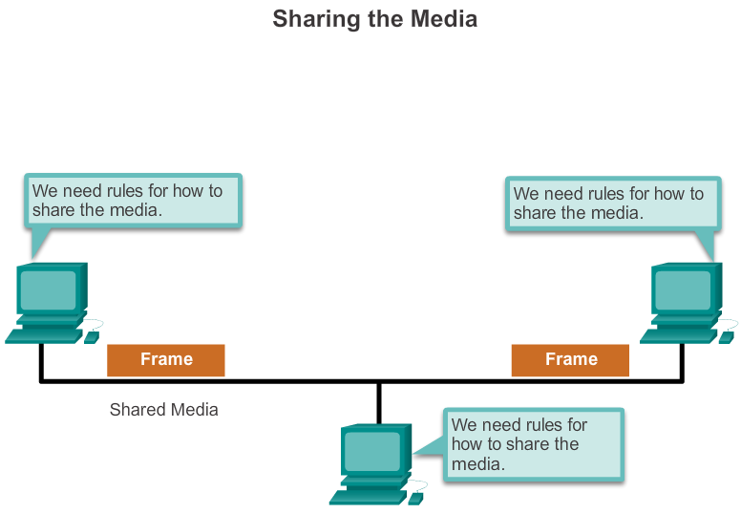
Topologies Controlling Access to the Media

Slide 47
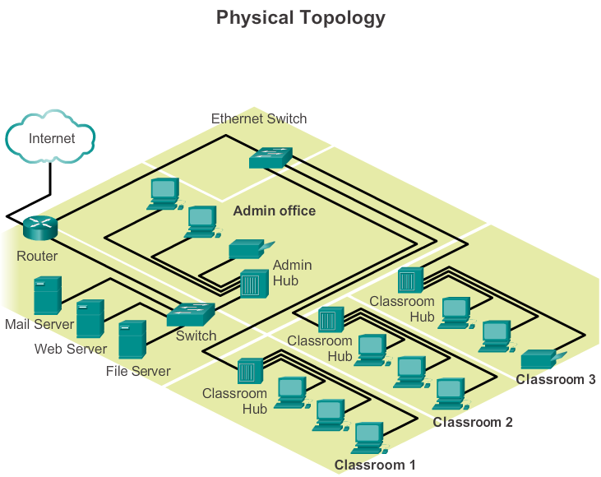
Topologies Physical and Logical Topologies

Slide 48
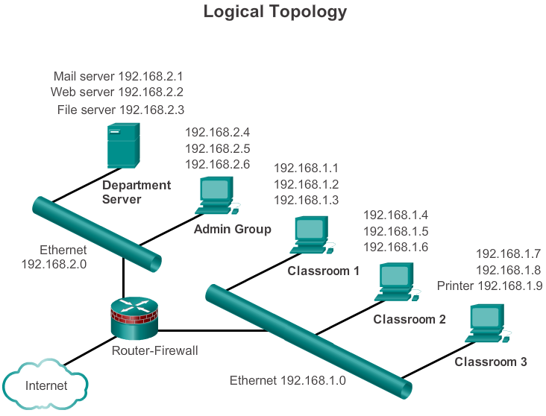
Topologies Physical and Logical Topologies (cont.)

Slide 49
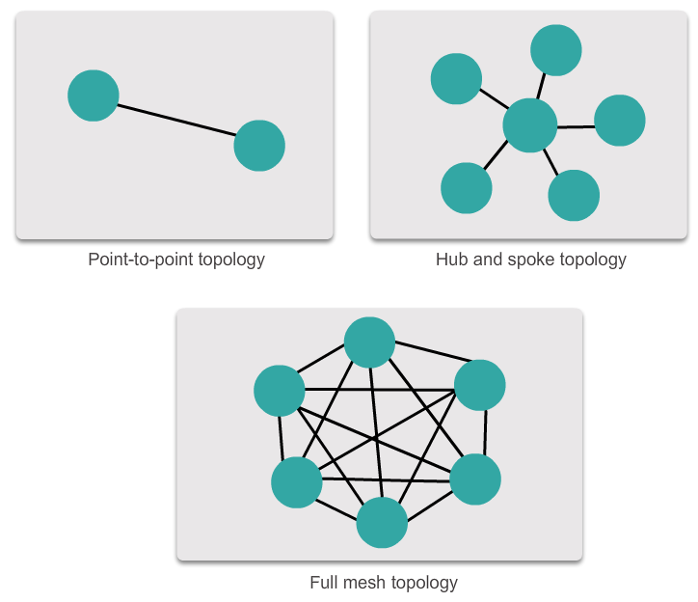
WAN Topologies Common Physical WAN Topologies

Slide 50
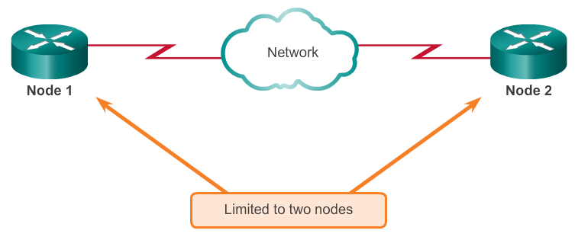
WAN Topologies Physical Point-to-Point Topology

Slide 51
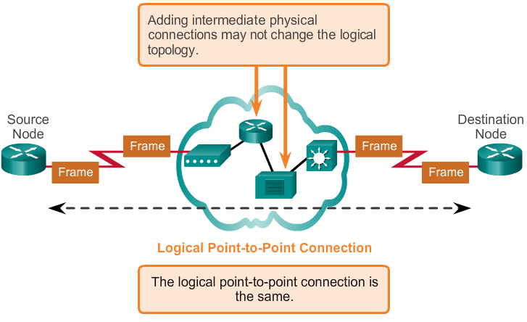
WAN Topologies Logical Point-to-Point Topology

Slide 52
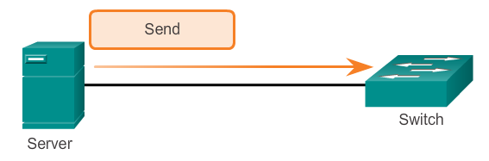
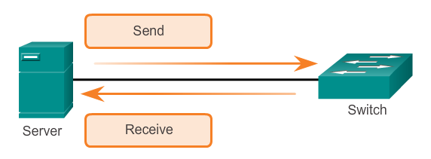
WAN Topologies Half- and Full-Duplex
Half-Duplex
Full-Duplex

Slide 53
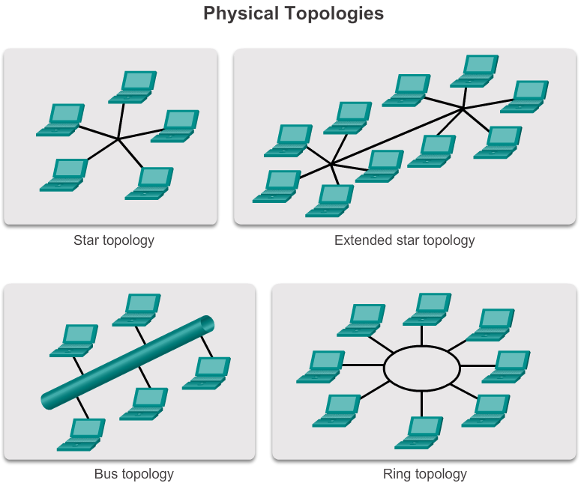
LAN Topologies Physical LAN Topologies

Slide 54
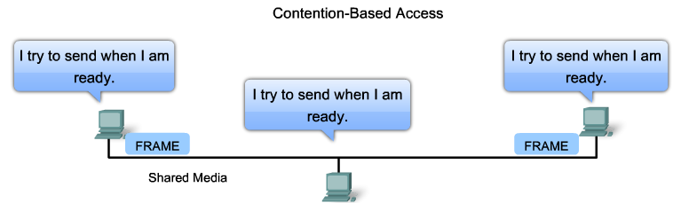
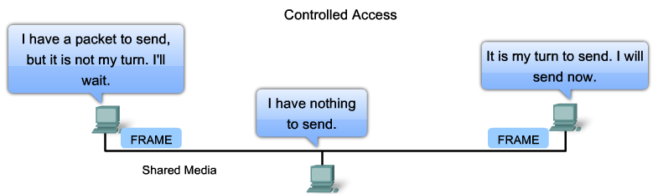
LAN Topologies Logical Topology for Shared Media

Slide 55
LAN Topologies Contention-Based Access
Characteristics | Contention-Based Technologies
Stations can transmit at any time Collision exist There are mechanisms to resolve contention for the media | CSMA/CD for 802.3 Ethernet networks CSMA/CA for 802.11 wireless networks

Slide 56
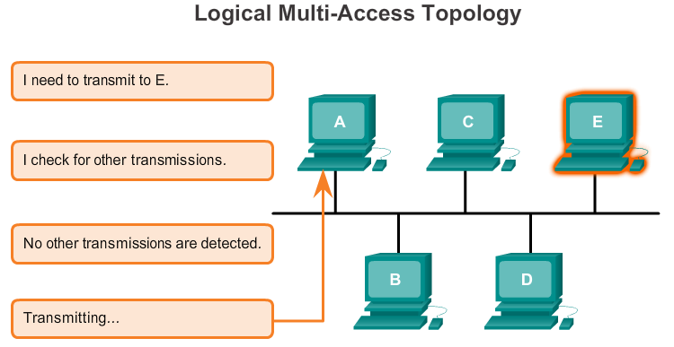
LAN Topologies Multi-Access Topology

Slide 57
LAN Topologies Controlled Access
Characteristics | Controlled Access Technologies
Only one station can transmit at a time Devices wanting to transmit must wait their turn No collisions May use a token passing method | Token Ring (IEEE 802.5) FDDI

Slide 58
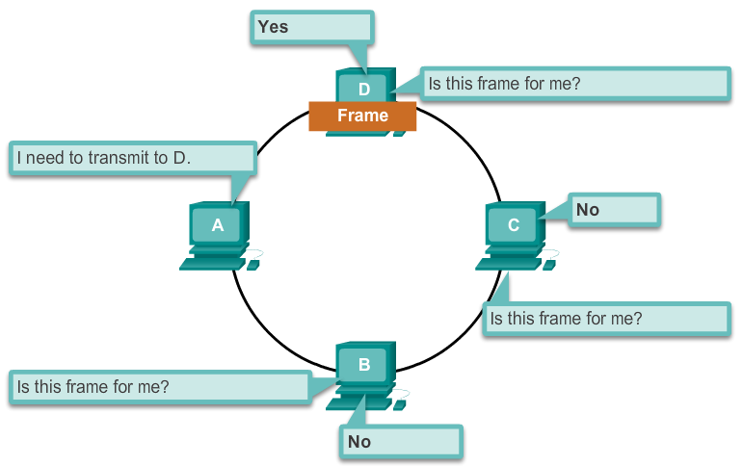
LAN Topologies Ring Topology

Slide 59
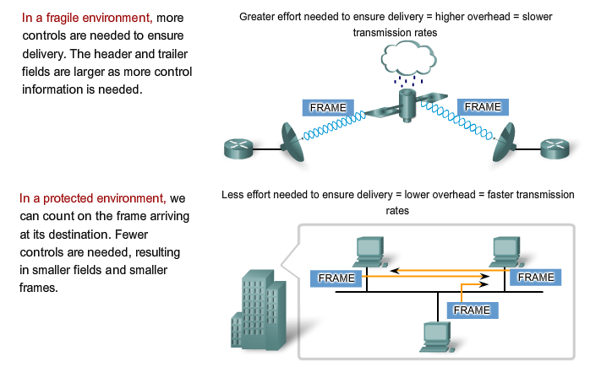
Data Link Frame The Frame

Slide 60
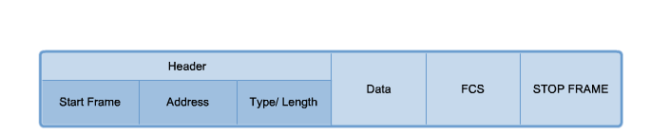
Data Link Frame The Header

Slide 61

Data Link Frame Layer 2 Address

Slide 62



Data Link Frame The Trailer

Slide 63

Data Link Frame LAN and WAN Frames

Slide 64

Data Link Frame Ethernet Frame

Slide 65

Data Link Frame Point-to-Point Protocol Frame

Slide 66

Data Link Frame 802.11 Wireless Frame

Slide 67
Network Access Summary
The TCP/IP network access layer is the equivalent of the OSI data link layer (Layer 2) and the physical layer (Layer 1).
The OSI physical layer provides the means to transport the bits that make up a data link layer frame across the network media.
The physical layer standards address three functional areas: physical components, frame encoding technique, and signaling method.
Using the proper media is an important part of network communications. Without the proper physical connection, either wired or wireless, communications between any two devices will not occur.
Wired communication consists of copper media and fiber cable.
There are three main types of copper media used in networking: unshielded-twisted pair (UTP), shielded-twisted pair (STP), and coaxial cable. UTP cabling is the most common copper networking media.

Slide 68
Network Access Summary (cont.)
Optical fiber cable has become very popular for interconnecting infrastructure network devices. It permits the transmission of data over longer distances and at higher bandwidths (data rates) than any other networking media.
Wireless media carry electromagnetic signals that represent the binary digits of data communications using radio or microwave frequencies.
The data link layer is responsible for the exchange of frames between nodes over a physical network media. It allows the upper layers to access the media and controls how data is placed and received on the media.
Among the different implementations of the data link layer protocols, there are different methods of controlling access to the media. These media access control techniques define if and how the nodes share the media.
The actual media access control method used depends on the topology and media sharing. LAN and WAN topologies can be physical or logical.

Slide 69
Network Access Summary (cont.)
WANs are commonly interconnected using the point-to-point, hub and spoke, or mesh physical topologies.
In shared media LANs, end devices can be interconnected using the star, bus, ring, or extended star (hybrid) physical topologies.
All data link layer protocols encapsulate the Layer 3 PDU within the data field of the frame. However, the structure of the frame and the fields contained in the header and trailer vary according to the protocol.

Slide 70


